Slide 1


Slide 2



JDBC DRIVERS
IN
JAVA

Slide 3

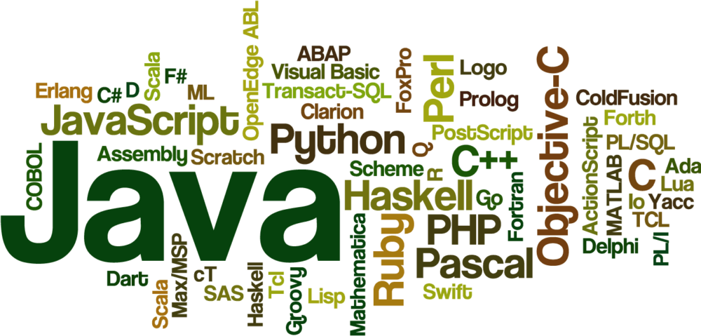


Slide 4
JDBC Driver
JDBC Driver is a software component that enables java application to interact with the database.
There are 4 types of JDBC drivers:
JDBC-ODBC bridge driver
Native-API driver (partially java driver)
Network Protocol driver (fully java driver)
Thin driver (fully java driver)

Slide 5
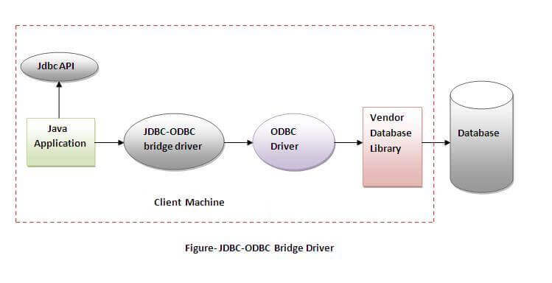
JDBC-ODBC bridge driver
The JDBC-ODBC bridge driver uses ODBC driver to connect to the database.
The JDBC-ODBC bridge driver converts JDBC method calls into the ODBC function calls. This is now discouraged because of thin driver.
Notes:
Oracle does not support the JDBC-ODBC Bridge from Java 8.
Oracle recommends that you use JDBC drivers provided by the vendor of your database instead of the JDBC-ODBC Bridge.

Slide 6
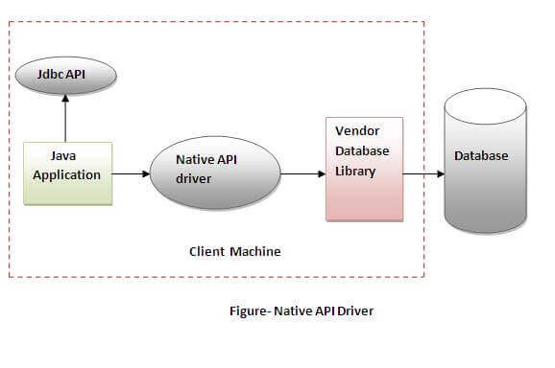
Native-API driver
The Native API driver uses the client-side libraries of the database.
The driver converts JDBC method calls into native calls of the database API. It is not written entirely in java.

Slide 7
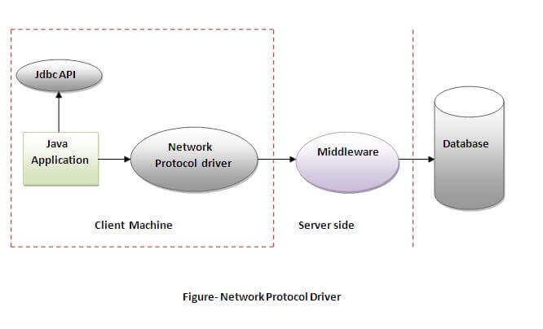
Network Protocol driver
The Network Protocol driver uses middleware (application server) that converts JDBC calls directly or indirectly into the vendor-specific database protocol.
It is fully written in java.

Slide 8
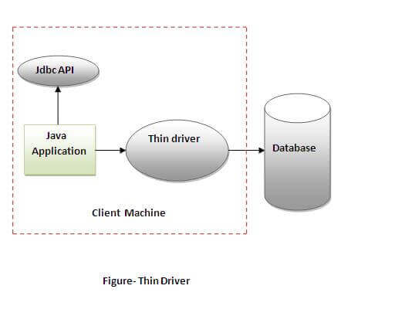
Thin driver
The thin driver converts JDBC calls directly into the vendor-specific database protocol.
That is why it is known as thin driver.
It is fully written in Java language.

Slide 9
IMPORTING THE PACKAGES:
import java.sql.* // JDBC packages.
import java.math.* // Java math packages; for example, these are required for the BigDecimal classes.
oracle.jdbc.driver.* and oracle.sql.* //Oracle packages to your program when you want to access the extended functionality provided by the Oracle drivers.

Slide 10
Java Database Connectivity with 5 Steps
There are 5 steps to connect any java application with the database using JDBC. These steps are as follows:
Register the Driver class
Create connection
Create statement
Execute queries
Close connection

Slide 11
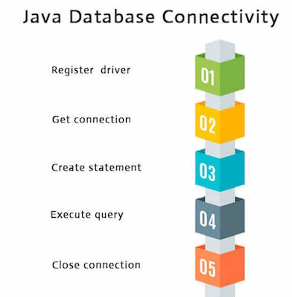
HIRERACHY:

Slide 12
Register the JDBC drivers
To access a database from a Java application, you must first provide the code to register your installed driver with your program.
with the static registerDriver() method of the java.sql.DriverManager class. This class provides a basic service for managing a set of JDBC drivers.
The registerDriver() method takes as input a "driver" class, that is, a class that implements the java.sql.Driver interface, as is the case with OracleDriver.

Slide 13
NOTE:
Alternatively, you can use the forName() method of the java.lang.Class class to load the JDBC drivers directly.
For example: Class.forName ("oracle.jdbc.OracleDriver");.
However, this method is valid only for JDK-compliant Java virtual machines. It is not valid for Microsoft Java virtual machines.
You register the driver only once in your Java application.
DriverManager.registerDriver (new oracle.jdbc.OracleDriver());

Slide 14
LOGIC: TO CONNECT THE MYSQL DATABASE
import java.sql.Connection; import java.sql.DriverManager; import java.sql.SQLException; // Notice, do not import com.mysql.jdbc.* // or you will have problems! public class LoadDriver { public static void main(String[] args) { try { // The newInstance() call is a work around for some // broken Java implementations Class.forName("com.mysql.jdbc.Driver").newInstance(); } catch (Exception ex) { // handle the error } } }

Slide 15
Create the connection object
The getConnection() method of DriverManager class is used to establish connection with the database.
public static Connection getConnection(String url)throws SQLException public static Connection getConnection(String url,String name,String password) throws SQLException

Slide 16
LOGIC: TO CONNECT TO MY SQL DATABASE
import java.sql.Connection; import java.sql.DriverManager; import java.sql.SQLException; Connection conn = null; ... try { conn = DriverManager.getConnection("jdbc:mysql://localhost/test?" + "user=minty&password=greatsqldb"); // Do something with the Connection ... } catch (SQLException ex) { // handle any errors System.out.println("SQLException: " + ex.getMessage()); System.out.println("SQLState: " + ex.getSQLState()); System.out.println("VendorError: " + ex.getErrorCode()); }

Slide 17
EXAMPLE:
Example to establish connection with the Oracle database
Connection con=DriverManager.getConnection( "jdbc:oracle:thin:@localhost:1521:xe","system","password");

Slide 18

THANK YOU

